Slide 1
The Pound Song
(to the tune of "Ten Little Indians")
10 little, 20 little, 30 little pennies.
40 little, 50 little, 60 little pennies.
70 little, 80 little, 90 little pennies.
100 pennies make a pound!
2 small, 4 small, 6 small 5ps.
8 small, 10 small, 12 small 5ps.
14 small, 16 small, 18 small 5ps.
20 5ps make a pound!
1 silver, 2 silver, 3 silver 10ps.
4 silver, 5 silver, 6 silver 10ps.
7 silver, 8 silver, 9 silver 10ps.
10 10ps make a pounds!

Slide 2
10 little, 20 little, 30 little pennies,

Slide 3
40 little, 50 little, 60 little pennies,

Slide 4
70 little, 80 little, 90 little pennies,

Slide 5
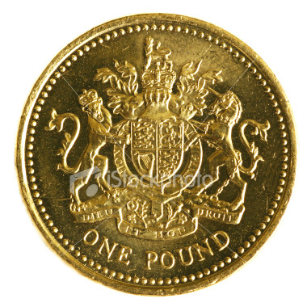
100 pennies make a pound.

Slide 6
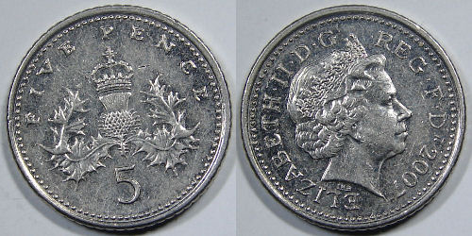
2 small, 4 small, 6 small 5ps,

Slide 7
8 small, 10 small, 12 small 5ps,

Slide 8
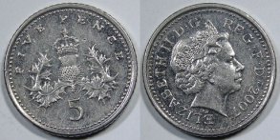
14 small, 16 small, 18 small 5ps,

Slide 9
20 5ps make a pound!

Slide 10
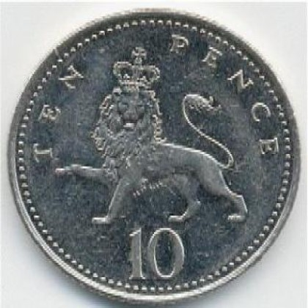
1 silver, 2 silver, 3 silver 10ps,

Slide 11
4 silver, 5 silver, 6 silver 10ps,

Slide 12
7 silver, 8 silver, 9 silver 10ps,

Slide 13
10 silver 10ps make a pound!

